Slide 1

Hidden, Bootstrap and Autosuggest Dropdowns
Mastering the art of handling complex dropdown elements in modern web automation testing. From hidden options to dynamic suggestions, we'll explore the techniques that make dropdown testing seamless and reliable.

Slide 2
Three Types of Complex Dropdowns
Hidden Dropdown
Bootstrap Dropdown
Auto Suggest/Complete
Options are hidden and disappear from the DOM, making direct inspection impossible. These elements require special techniques to access and interact with.
Modern web applications commonly use Bootstrap dropdowns that don't rely on traditional select tags, requiring different automation approaches.
Dynamic options that appear as you type, typically fetched from servers at runtime. These require real-time interaction handling.

Slide 3
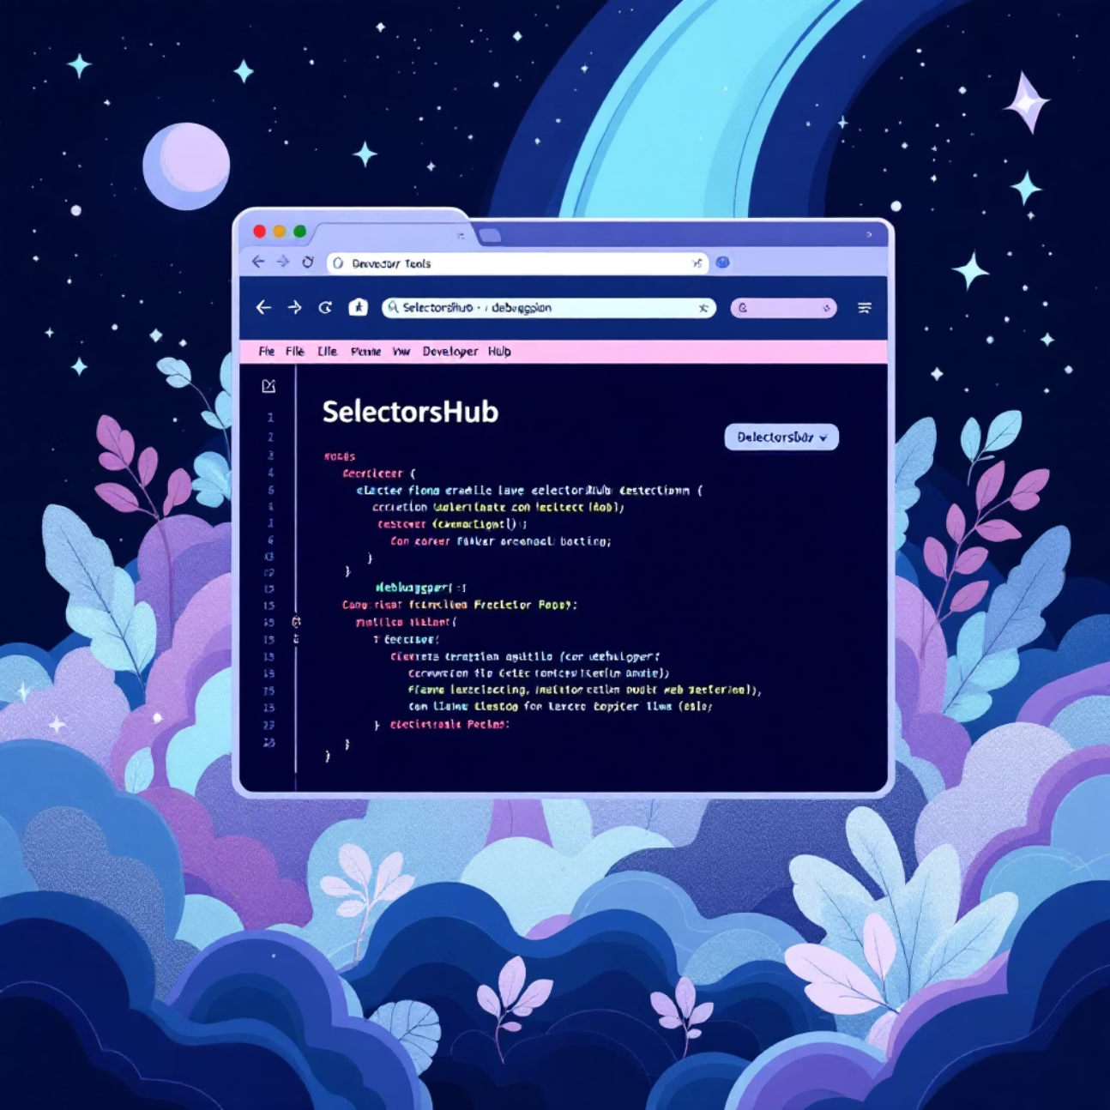
Technique 1: SelectorsHub Debugger
The simplest approach to handling hidden dropdown options is using SelectorsHub's built-in debugger functionality. This tool allows you to pause the DOM state and inspect elements that would otherwise disappear.
Simply turn on the Debugger option in SelectorsHub to freeze the dropdown state and make hidden elements accessible for inspection and interaction.

Slide 4
Technique 2: Emulate Focused Page
01
02
03
Open the DOM
Press Ctrl+Shift+P
Type "emulate a focused page"
Access your browser's developer tools and navigate to the DOM inspector.
Open the command palette using this keyboard shortcut.
Search for and select this option to freeze the page state.
04
05
Locate hidden elements
Disable emulation
Now you can inspect and interact with previously hidden dropdown options.
Repeat steps 1-2, then type "Do not emulate a focused page" to return to normal state.

Slide 5
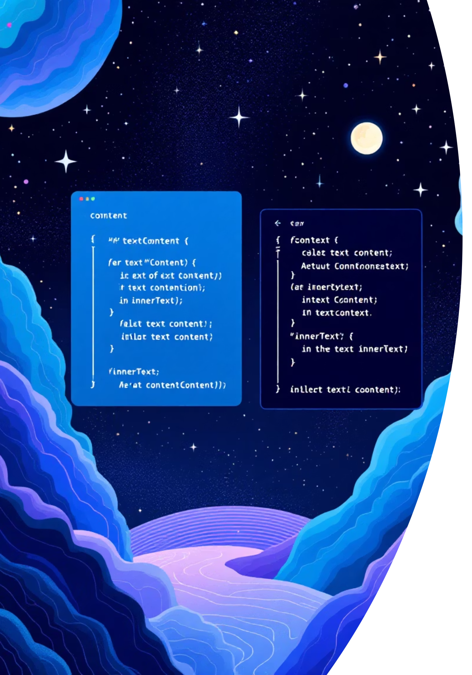
textContent() vs innerText(): The Key Differences
In Playwright, both methods retrieve text from web elements, but they handle visibility and formatting very differently. Understanding these differences is crucial for reliable test automation.

Slide 6

textContent() Method
What it Returns
const text = await page.locator('selector').textContent();
Returns the raw text content, including hidden elements and extra whitespace exactly as it appears in the DOM.
Perfect for extracting raw data that might be hidden from users but present in the DOM structure.
Key Characteristics
Includes text from hidden elements (display: none)
Preserves extra whitespaces and line breaks
Ignores CSS visibility rules
Best Use Case
When you need exact DOM text for parsing, regardless of visibility or formatting.

Slide 7

innerText() Method
What it Returns
const visibleText = await page.locator('selector').innerText();
Returns the visible rendered text, similar to what a user actually sees on the screen.
Ideal for testing what users actually see and interact with on the page.
Key Characteristics
Excludes hidden elements and invisible text
Normalizes whitespace and line breaks
Respects CSS visibility rules
Best Use Case
When you want to verify visible text for user-facing assertions and testing scenarios.

Slide 8
Comparison Example
Sample DOM Structure:
<div> Welcome <span style="display: none">To India</span></div>
textContent() Result
innerText() Result
"Welcome To India"
"Welcome"
Includes the hidden text "To India" because it exists in the DOM structure.
Only shows visible text, excluding the hidden "To India" portion.
Feature
textContent()
innerText()
Visibility matters?
No
Yes
Whitespace?
Preserved as-is
Normalized
Hidden text?
Included
Excluded
Use case
Exact DOM text
Visible user text

Slide 9






Essential Playwright Concepts Summary
page.locator()
fill() & click()
Locate single or group of elements on the page for interaction and testing.
Type text into input fields and click on buttons or elements.
waitForTimeout()
count() & nth()
Wait for specified seconds during test execution.
Get number of matching elements and access specific elements in a group.
Text Extraction
Loop Through Options
Use textContent() or innerText() to get text from elements based on your needs.
Dynamically print and select dropdown items using iteration techniques.

